Slide 1
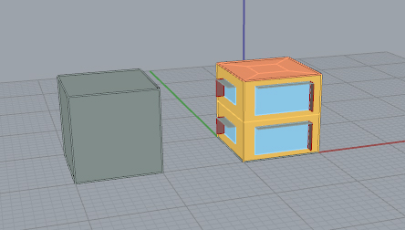
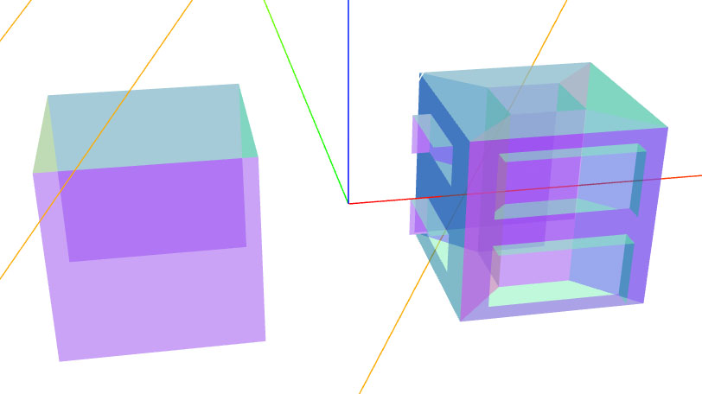
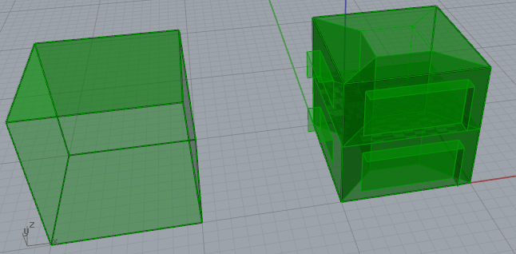
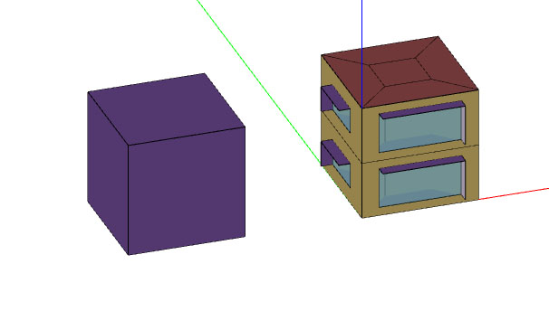
OS/gbXML Geometry Topology
gbXML Viewer
Rhino
OSM

Slide 2
First some small unit examples…

Slide 3
Zone Numbers ClockWise starting with lower middle zone
(0,0,0)
<Space zoneIdRef="zone" id="space-1" buildingStoreyIdRef="storey-1">
<Name>space-1</Name>
<Area>21.000000</Area>
<Volume>105.000000</Volume>
</Space>
<Space zoneIdRef="zone-5" id="space-5" buildingStoreyIdRef="storey-1">
<Name>space-5</Name>
<Area>16.000000</Area>
<Volume>80.000000</Volume>
</Space>
<Space zoneIdRef="zone-4" id="space-4" buildingStoreyIdRef="storey-1">
<Name>space-4</Name>
<Area>21.000000</Area>
<Volume>105.000000</Volume>
</Space>
<Space zoneIdRef="zone-3" id="space-3" buildingStoreyIdRef="storey-1">
<Name>space-3</Name>
<Area>21.000000</Area>
<Volume>105.000000</Volume>
</Space>
<Space zoneIdRef="zone-2" id="space-2" buildingStoreyIdRef="storey-1">
<Name>space-2</Name>
<Area>21.000000</Area>
<Volume>105.000000</Volume>
</Space>
Space.3
Space.2
Space.5
Space.4
Space.1
Y
X

Slide 4
Surface References to Define Surface Geometry
Y
(0,0,0)
(same for external walls and windows)
X
OR
OR
OR
OR
OR
(same for external walls and windows)
(same for external walls and windows)
OR
OR
OR
(same for external walls and windows)
*Note: All internal walls defined only once, coordinates simply need to start in upper left-hand corner and be counterclockwise (from either side view)

Slide 5
Nodes for External Walls
= normal
<Surface id="surface-1" surfaceType="ExteriorWall">
<AdjacentSpaceId spaceIdRef="space-1"/>
<RectangularGeometry>
<Azimuth>180</Azimuth>
</RectangularGeometry>
<PlanarGeometry>
<PolyLoop>
<CartesianPoint>
<Coordinate>0.000000</Coordinate>
<Coordinate>0.000000</Coordinate>
<Coordinate>10.000000</Coordinate>
</CartesianPoint>
<CartesianPoint>
<Coordinate>0.000000</Coordinate>
<Coordinate>0.000000</Coordinate>
<Coordinate>0.000000</Coordinate>
</CartesianPoint>
<CartesianPoint>
<Coordinate>20.000000</Coordinate>
<Coordinate>0.000000</Coordinate>
<Coordinate>0.000000</Coordinate>
</CartesianPoint>
<CartesianPoint>
<Coordinate>20.000000</Coordinate>
<Coordinate>0.000000</Coordinate>
<Coordinate>10.000000</Coordinate>
</CartesianPoint>
</PolyLoop>
</PlanarGeometry>
Space 1
(20,0,10)
Node 1
Node 4
(0,0,10)
Node 2
Node 3
(0,0,0)
(20,0,0)
(As viewed from the outside)
One Adjacent Space ID is listed for Walls, none for Openings.
*Same applies for Adjacent Buildings, but no Adjacent Space
*Azimuth always starting azimuth (0, 90, 180, 270) + Orientation (or Site Orientation in case of Adjacent Buildings).

Slide 6
Nodes for External Windows
= normal
<Opening openingType="FixedWindow" id="opening-1">
<RectangularGeometry>
<Azimuth>180</Azimuth>
</RectangularGeometry>
<PlanarGeometry>
<PolyLoop>
<CartesianPoint>
<Coordinate>4.000000</Coordinate>
<Coordinate>0.000000</Coordinate>
<Coordinate>7.0000</Coordinate>
</CartesianPoint>
<CartesianPoint>
<Coordinate>4.000000</Coordinate>
<Coordinate>0.000000</Coordinate>
<Coordinate>3.000000</Coordinate>
</CartesianPoint>
<CartesianPoint>
<Coordinate>16.000000</Coordinate>
<Coordinate>0.000000</Coordinate>
<Coordinate>3.000000</Coordinate>
</CartesianPoint>
<CartesianPoint>
<Coordinate>16.000000</Coordinate>
<Coordinate>0.00000</Coordinate>
<Coordinate>7.00000</Coordinate>
</CartesianPoint>
</PolyLoop>
</PlanarGeometry>
</Opening>
</Surface>
Space 1
Node 1
Node 4
(4,0,7)
(16,0,7)
Node 2
Node 3
(4,0,3)
(16,0,3)
(As viewed from the outside)
One Adjacent Space ID is listed for Walls, none for Openings.
*Azimuth always starting azimuth (0, 90, 180, 270) + Orientation.

Slide 7
Nodes for Roof Surfaces
The reference point for roofs is looking down at the surface from above, with your head pointing in any direction. The starting point may arbitrarily selected, but once selected, Node 2 must be counterclockwise.
Node 1
Node 4
<Surface id="surface-2" surfaceType="Roof">
<AdjacentSpaceId spaceIdRef="space-1"/>
<RectangularGeometry>
<Azimuth>90</Azimuth>
</RectangularGeometry>
<PlanarGeometry>
<PolyLoop>
<CartesianPoint>
<Coordinate>3.000000</Coordinate>
<Coordinate>7.000000</Coordinate>
<Coordinate>10.000000</Coordinate>
</CartesianPoint>
<CartesianPoint>
<Coordinate>3.000000</Coordinate>
<Coordinate>3.000000</Coordinate>
<Coordinate>10.000000</Coordinate>
</CartesianPoint>
<CartesianPoint>
<Coordinate>7.000000</Coordinate>
<Coordinate>3.000000</Coordinate>
<Coordinate>10.000000</Coordinate>
</CartesianPoint>
<CartesianPoint>
<Coordinate>7.000000</Coordinate>
<Coordinate>7.000000</Coordinate>
<Coordinate>10.000000</Coordinate>
</CartesianPoint>
</PolyLoop>
</PlanarGeometry>
</Surface>
(0,8,10)
(20,8,10)
= normal
Node 2
Node 3
(0,0,10)
(20,0,10)
Space 1
Y
One Adjacent Space ID is listed for Roofs.
X
*Same applies for Adjacent Buildings, but no Adjacent Space
*Azimuth always 90.

Slide 8
Nodes for Ground Slab Surfaces
The reference point for ground slabs is looking up at the surface from below, with your head pointing in any direction. The starting point may arbitrarily selected, but once selected, Node 2 must be counterclockwise.
<Surface id="surface-3" surfaceType="SlabOnGrade">
<AdjacentSpaceId spaceIdRef="space-1"/>
<RectangularGeometry>
<Azimuth>90</Azimuth>
</RectangularGeometry>
<PlanarGeometry>
<PolyLoop>
<CartesianPoint>
<Coordinate>20.000000</Coordinate>
<Coordinate>8.000000</Coordinate>
<Coordinate>0.000000</Coordinate>
</CartesianPoint>
<CartesianPoint>
<Coordinate>20.000000</Coordinate>
<Coordinate>0.000000</Coordinate>
<Coordinate>0.000000</Coordinate>
</CartesianPoint>
<CartesianPoint>
<Coordinate>0.000000</Coordinate>
<Coordinate>0.000000</Coordinate>
<Coordinate>0.000000</Coordinate>
</CartesianPoint>
<CartesianPoint>
<Coordinate>0.000000</Coordinate>
<Coordinate>8.000000</Coordinate>
<Coordinate>0.000000</Coordinate>
</CartesianPoint>
</PolyLoop>
</PlanarGeometry>
</Surface>
= normal
Space 1
Node 4
Node 1
Y
(0,8,0)
(20,8,0)
Node 3
Node 2
(0,0,0)
(20,0,0)
X
One Adjacent Space ID is listed for BaseSlabs.
*Azimuth always 90.

Slide 9
Nodes for Internal Floor/Ceiling Surfaces
Every internal ceiling for a zone also serves as an internal floor for the zone above. When the surface is first defined, either as a ceiling or as a floor, the starting point may be arbitrarily selected. Node 2 must be counterclockwise from that point, etc. For SPEED lets always use Ceiling.
Example: The reference point for internal ceilings is looking down at the surface from above with your head pointing in any direction. The starting point may arbitrarily selected, but once selected, Node 2 must be counterclockwise. The surface need not be defined again as an InteriorFloor.
<Surface id="surface-4" surfaceType="Ceiling">
<AdjacentSpaceId spaceIdRef="space-1"/>
<AdjacentSpaceId spaceIdRef="space-3"/>
<RectangularGeometry>
<Azimuth>90</Azimuth>
</RectangularGeometry>
<PlanarGeometry>
<PolyLoop>
<CartesianPoint>
<Coordinate>0.000000</Coordinate>
<Coordinate>8.000000</Coordinate>
<Coordinate>10.000000</Coordinate>
</CartesianPoint>
<CartesianPoint>
<Coordinate>0.000000</Coordinate>
<Coordinate>0.000000</Coordinate>
<Coordinate>10.000000</Coordinate>
</CartesianPoint>
<CartesianPoint>
<Coordinate>20.000000</Coordinate>
<Coordinate>0.000000</Coordinate>
<Coordinate>10.000000</Coordinate>
</CartesianPoint>
<CartesianPoint>
<Coordinate>20.000000</Coordinate>
<Coordinate>8.000000</Coordinate>
<Coordinate>10.000000</Coordinate>
</CartesianPoint>
</PolyLoop>
</PlanarGeometry>
</Surface>
= normal
Space 3
Node 1
Node 4
(0,8,10)
(20,8,10)
Node 2
Node 3
(0,0,10)
(20,0,10)
Space 1
Y
Two Adjacent Space IDs are listed for all Ceilings. The first Adjacent Space ID listed MUST be the one for which the normal is pointing away. So in this case, Space 1 is the first Adjacent Space ID and Space 3 is the second listed.
X
*Azimuth always 90.

Slide 10
Nodes for Internal Wall Surfaces
For EnergyPlus, all internal walls are defined only once. Here is an example for an internal wall:
<Surface id="surface-5" surfaceType="InteriorWall">
<AdjacentSpaceId spaceIdRef="space-2"/>
<AdjacentSpaceId spaceIdRef="space-1"/>
<RectangularGeometry>
<Azimuth>0</Azimuth>
</RectangularGeometry>
<PlanarGeometry>
<PolyLoop>
<CartesianPoint>
<Coordinate>20.000000</Coordinate>
<Coordinate>0.000000</Coordinate>
<Coordinate>10.000000</Coordinate>
</CartesianPoint>
<CartesianPoint>
<Coordinate>20.000000</Coordinate>
<Coordinate>0.000000</Coordinate>
<Coordinate>0.000000</Coordinate>
</CartesianPoint>
<CartesianPoint>
<Coordinate>20.000000</Coordinate>
<Coordinate>8.000000</Coordinate>
<Coordinate>0.000000</Coordinate>
</CartesianPoint>
<CartesianPoint>
<Coordinate>20.000000</Coordinate>
<Coordinate>8.000000</Coordinate>
<Coordinate>10.000000</Coordinate>
</CartesianPoint>
</PolyLoop>
</PlanarGeometry>
</Surface>
= normal
Node 4
(20,8,10)
Node 1
(20,0,10)
Space 1
Space 2
Z
Node 3
(20,8,0)
Node 2
(20,0,0)
X or Y
Two Adjacent Space IDs are listed for all Interior Walls. The first Adjacent Space ID listed MUST be the one for which the normal is pointing away. So in this case, Space 2 is the first Adjacent Space ID and Space 1 is the second listed.
*Azimuth calculated same way as for exterior walls, but can be ignored for SPEED (i.e. put 0)

Slide 11
Nodes for Overhangs
= normal
<Surface id="shade-1" surfaceType="Shade">
<Name>Overhang</Name>
<RectangularGeometry>
<Azimuth>180</Azimuth>
</RectangularGeometry>
<PlanarGeometry>
<PolyLoop>
<CartesianPoint>
<Coordinate>4.000000</Coordinate>
<Coordinate>0.000000</Coordinate>
<Coordinate>7.000000</Coordinate>
</CartesianPoint>
<CartesianPoint>
<Coordinate>4.000000</Coordinate>
<Coordinate>-2.000000</Coordinate>
<Coordinate>7.000000</Coordinate>
</CartesianPoint>
<CartesianPoint>
<Coordinate>16.000000</Coordinate>
<Coordinate>-2.000000</Coordinate>
<Coordinate>7.000000</Coordinate>
</CartesianPoint>
<CartesianPoint>
<Coordinate>16.000000</Coordinate>
<Coordinate>0.000000</Coordinate>
<Coordinate>7.000000</Coordinate>
</CartesianPoint>
</PolyLoop>
</PlanarGeometry>
</Surface>
Node 4
Node 1
(16,0,7)
(4,0,7)
Node 3
Node 2
(4,-2,7)
(16,-2,7)
(As viewed from the above down for overhangs)
*Azimuth=same as adjacent wall for SPEED.

Slide 12
Nodes for Fins
= normal
<Surface id="shade-2" surfaceType="Shade">
<Name>Fin</Name>
<RectangularGeometry>
<Azimuth>180</Azimuth>
</RectangularGeometry>
<PlanarGeometry>
<PolyLoop>
<CartesianPoint>
<Coordinate>16.000000</Coordinate>
<Coordinate>-2.000000</Coordinate>
<Coordinate>7.000000</Coordinate>
</CartesianPoint>
<CartesianPoint>
<Coordinate>16.000000</Coordinate>
<Coordinate>-2.000000</Coordinate>
<Coordinate>3.000000</Coordinate>
</CartesianPoint>
<CartesianPoint>
<Coordinate>16.000000</Coordinate>
<Coordinate>0.000000</Coordinate>
<Coordinate>3.000000</Coordinate>
</CartesianPoint>
<CartesianPoint>
<Coordinate>16.000000</Coordinate>
<Coordinate>0.000000</Coordinate>
<Coordinate>7.000000</Coordinate>
</CartesianPoint>
</PolyLoop>
</PlanarGeometry>
</Surface>
Node 4
(16,0,7)
Node 1
(16,-2,7)
Node 3
(16,0,3)
Node 2
(16,-2,3)
(As viewed from outside to outer facing surface for fins)
*Azimuth=same as adjacent wall for SPEED.

Slide 13
Next, our test case…

Slide 14
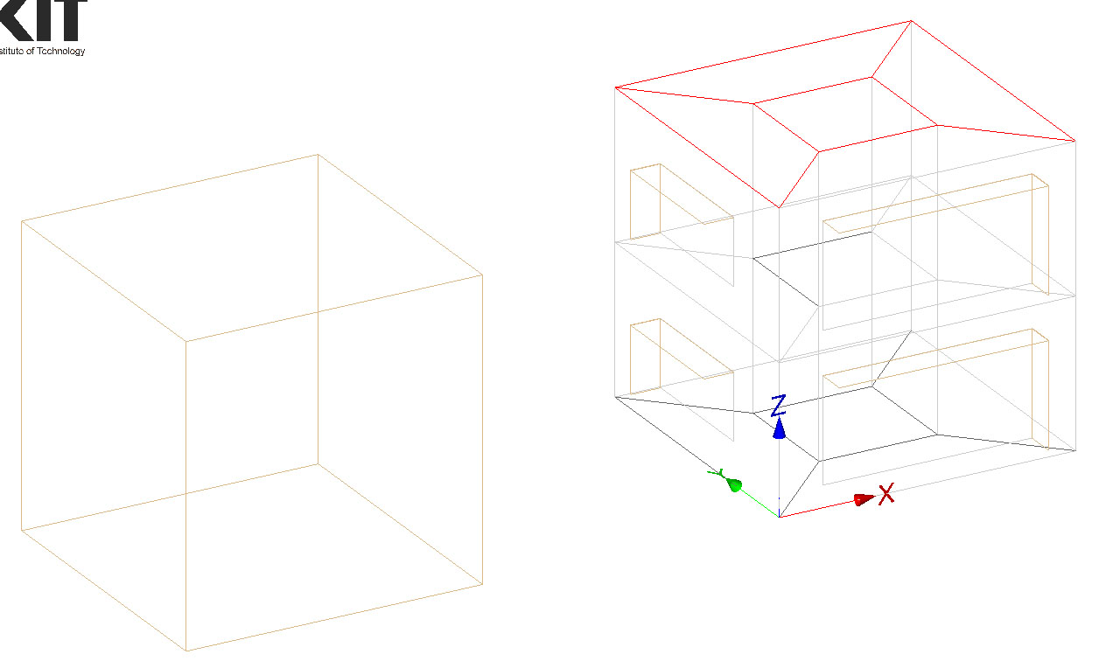
Adjacent Building Coordinates
Space 8
Space 10
Space 9
(-10,10,10)
Space 7
Space 6
(-20,10,10)
(-10,0,10)
Space 3
Space 5
Space 4
(-10,10,0)
Space 1
Space 2
(-20,10,0)
(-10,0,0)
(-20,0,0)

Slide 15
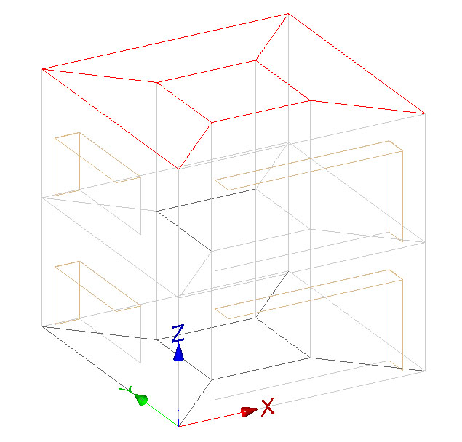
= Shading Node
(10, 10, 10)
= Exterior Surface Node
= Interior Surface Node
Space 8
=Window Surface Node
(7, 7, 10)
(0, 10, 10)
Space 9
(3, 7, 10)
Space 10
(7, 3, 10)
Space 6
(10, 0, 10)
(-1, 7.24, 8.6)
Space 7
(3, 3, 10)
(8.53, 0, 9.27)
(0, 7.24, 8.6)
(10, 10, 5)
(8.53, -1, 9.27)
(0, 2.76, 8.6)
(1.46, 0, 9.27)
(0, 0, 10)
(-1, 7.24, 6.38)
(-1, 2.76, 8.6)
(0, 7.24, 6.38)
(7, 7, 5)
(0, 10, 5)
(1.46, -1, 9.27)
(3, 7, 5)
(7, 3, 5)
(8.53, 0, 5.73)
(10, 0, 5)
(0, 2.76, 6.38)
(8.53, -1, 5.73)
(-1, 7.24, 3.62)
(0, 7.24, 3.62)
(3, 3, 5)
(8.53, 0, 4.26)
(1.46, 0, 5.73)
(10, 10, 0)
(8.53, -1, 4.26)
(0, 2.76, 3.62)
(0, 0, 5)
(1.46, 0, 4.26)
(0, 7.24, 1.38)
Space 3
(-1, 7.24, 1.38)
(-1, 2.76, 3.62)
(7, 7, 0)
(0, 10, 0)
(1.46, -1, 4.26)
Space 4
(3, 7, 0)
Space 5
(8.53, 0, 0.73)
(0, 2.76, 1.38)
(7, 3, 0)
(10, 0, 0)
Space 2
(3, 3, 0)
Space 1
(8.53, -1, 0.73)
(1.46, 0, 0.73)
(0, 0, 0)

